Slide 1


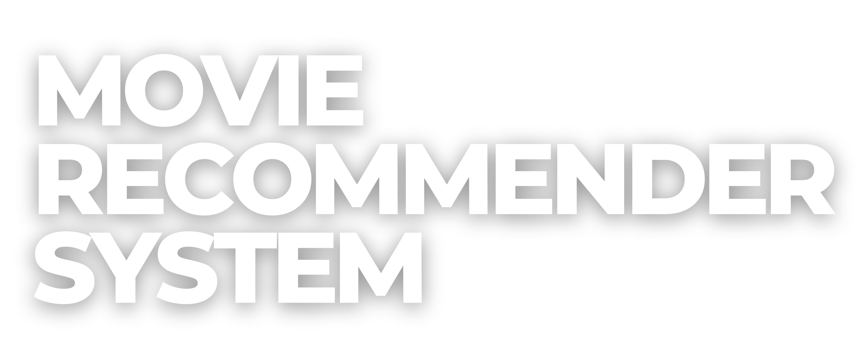

Slide 2


TABLE OF
CONTENTS
About Us
Project Overview Exploratory Data Analysis Modelling
Model Performance Model Explanation Streamlit Application Conclusion

Slide 3
ABOUT US
Our Philosophy
Innovations designed to create a better world
Our Mission Our Goals
To deliver services that transform the way companies do business
To provide data driven solutions that will help grow businesses

Slide 4

PROJECT OVERVIEW
Movie Recommender Systems
Economical benefits of the movie recommender system

Slide 5

PROBLEM STATEMENT
Construct a recommendation system based on content or collaborative filtering that is capable of making movies recommendations for users based on the users’ rating of a particular movie

Slide 6
EXPLORATORY DATA ANALYSIS
Findings
Large dataset that leads to memory error
Dimensionality reduction techniques were used to reduce dataset size

Slide 7
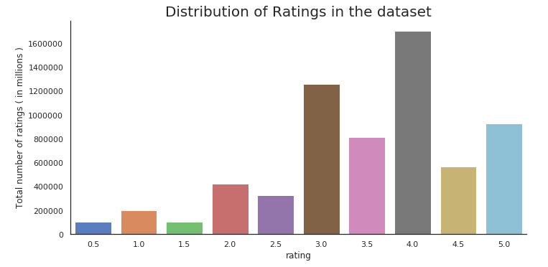
EXPLORATORY DATA ANALYSIS

Slide 8
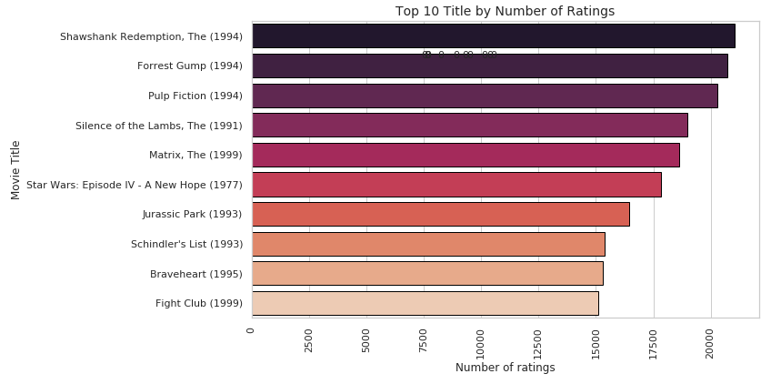
EXPLORATORY DATA ANALYSIS

Slide 9
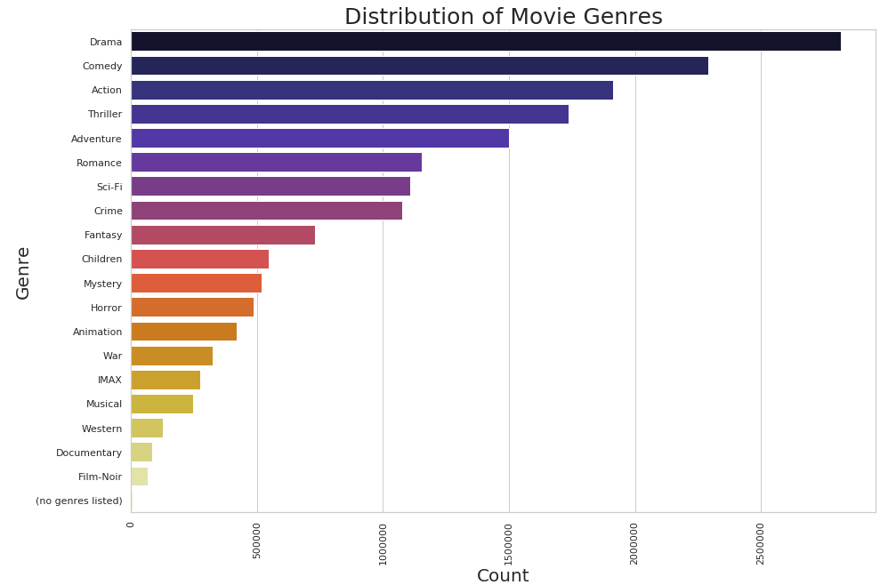
EXPLORATORY DATA ANALYSIS

Slide 10
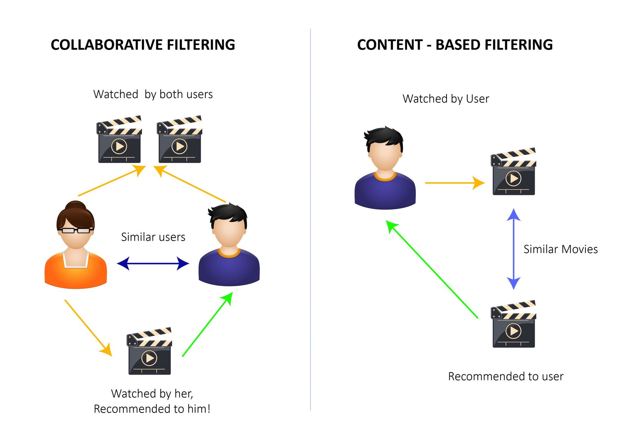
MODELLING

Slide 11

MODEL PERFORMANCE

Slide 12
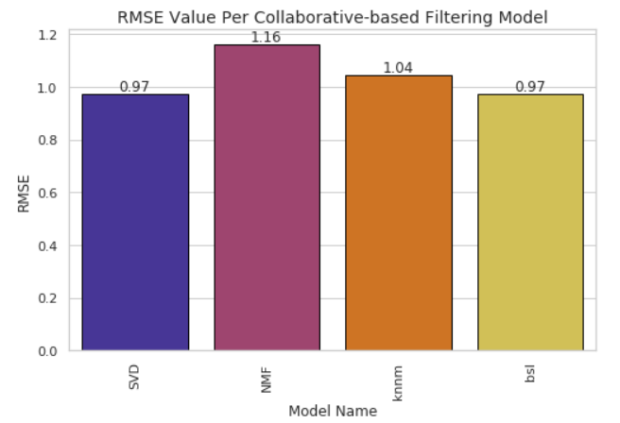
MODEL PERFORMANCE

Slide 13
MODEL EXPLANATION
Collaborative Filtering
Chosen Model:
SVD (Singular Value Decomposition)

Slide 14

STREAMLIT APPLICATION

Slide 15
CONCLUSION
Recommender System uses a SVD model to produce movie predictions.
The Recommender System improves user experience.
Why should you choose us?

Slide 16






CONTACT US
21st Century Tech Solution
21st Century Tech Solution
21stcenturytechsolution
21stcenturytechsolution contact@techsolution

